Slide 1

ASPIRING FUTURE MINDS
Start - Up Proposal

Slide 2


Content
01
02
03
04
05
06
07
Idea
Solution
SWOT Analysis
Marketing Channel
Cost Structure
Competitors
Market Trend and Future Goals

Slide 3





Idea
To Provide education to all aspiring candidates across every DISTRICTS in TAMILNADU at Affordable COST
A) CITIES - APP RENDERING FACILITY AND PROMOTIONS THROUGH SOCIAL MEDIA.
01
B) VILLAGES - POSTER, TV ADS
OUR MAIN MOTIVE IS TO IMPROVISE:
TO TEACH UPDATED TECHNOLOGY
PRACTICAL LEARNING DIRECTLY
SENDING THEM TO CORPORATES
02
WE MAKE PRIMARY ARRANGEMNTS WITH LEADING CORPORATES
TO MAKE SURE THE CANDIDATE HAS EXCEPTIONAL SKILLS AND TRAINED
WITH DOMAIN KNOWLEDGE
03
PROVING THE LEVEL OF KNOWLEDEGE EACH CANDIDATE HAS ; WE PROMOTE FUNDING FROM PRIVATE CORPORATES TO CANDIDATES WHO ARE FINANCIALLY NOT STABLE LIKE PROVIDING SCHOLARSHIPS
04

Slide 4
PROGRESS 1
WHY
CHOOSE US
We are here to guide and teach the students about the new era of tech and tools used in the big gaint corporates. It is scheduled class for three days in a week. (2 - Online; 1 - Practical)*Practical only on Sundays*
Our headquarters only featured in TamilNadu:
CHENNAI
COIMBATORE
TRICHY
MADURAI
SALEM
KANYAKUMARI
** FIRST COME FIRST SERVE BASIS ON REGISTERING THE COURSE (I NITI ALLY PAY RS 1 00)**
FOR THEORY CLASS : WILL HAVE AN ACCESS TO LEARN IN ONLINE MODE
FOR PRACTICAL CLASS: TRANSPORT FACI LITY IS ARRANGED, CONDUCTED IN NEARBY HEADQUARTERS.
PROGRESS 2
1 0 0 PERCENT GUARANTEE ON THE RESULT
TO GET PLACED IN CORPORATES
GAIN INDUSTRIAL EXPERIENCES
LIMIT ONLY UPTO 40-70 STUDENTS (EACH BATCH)
PROGRESS 3
CANDIDATES WILL GAI N AN ADVANTAGE :
1) TO LEARN BOTH I N TAMI L AND ENGLISH
** STUDENTS OUTSIDE TAMILNADU WILL GET ONLY ONLINE TEACHI NG IN ENGLISH**

Slide 5


SWOT ANALYSIS
STRENGTH
EXPERIENCED INDUTRY EXPERTS 7-10 YRS
100+ UPDATED COURSES TAUGHT
FLEXIBLE TIMING & GOOD LAB FACILITY
WEAKNESS
LIMITED BRAND AWARENESS
HIGH FACULTY TURNOVER
INVEST HUGE IN RESOURCES
OPPOURTUNITIES
CORPORATE PARTENERSHIPS (100+)
LEVEL TO LEARN ( ZERO TO PRO )
PROMOTE FUNDING - BASED ON ABILITY
THREAT
INTENSE COMPETITIONS (OUTSIDE TN)
ECONOMIC VOLTALITY
TECHNOLOGICAL DISRUPTIONS

Slide 6



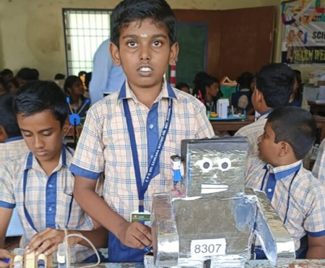

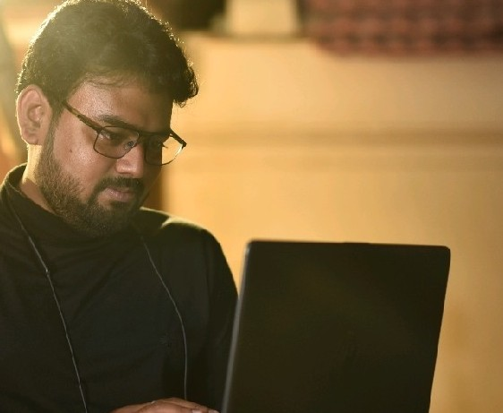
Target Audience
$ 1 SCHOOL STUDENTS
$ 2 COLLEGE STUDENTS
$ 3 PROFESSIONALS
WORK ONLY ON PROJECTS : TO DEVELOP THE THINKING ABILITY
BASICALLY FIRST WE TRY THEM TO FOCUS MORE ON AUTOMATION AND AI
PROJECTS
REGULARLY PARTICIPATE IN CONTESTS
STUDENTS WHO ARE HOLDING UG,PG DEGEES ARE ELIGIBLE HERE.( EVEN FRESHERS)
NEW AND TRENDING COURSES FROM BASIC TO ADAVANCE WILL BE TAUGHT
WORK ON REAL TIME PROJECTS
PROVIDED UPDATED TOOLS WILL BE TAUGHT (CAUSE FAMILIAR TO USE)
DOUBT CLEARING SESSION (INDIVIDUALLY)
GIVING MOCK INTERVIEWS

Slide 7


MARKETI NG CHANNEL
2
DEVELOP STRONG BRAND I DENTI TY
3
ONLINE PRESENCE AND ENGAGEMENT
1
RESEARCH YOUR AUDIENCE
4
MULTI CHANNEL PROMOTION
5
CORPORATE PARTNERSHI PS

Slide 8


4 ) TEACHI NG
FEES - Rs 2000 PY (50 MEM)
3 ) PAI D WORKER
FEES - Rs 5500 PY (40 MEM)
COST STRUCTURE
2 ) UG/ PG
FEES - Rs 8500 PY (50 - 70 MEM)
1 ) School
FEES - Rs 2500 PY (50 MEM)

Slide 9



FUTURE TREND
0 - 3 YR
3 - 5 YR
>> 5YR
>>30
Definitely, by the graph it is depicted there is a bigger market for college students.
>>20
>>10
>>0
College
School
Teaching
Professionals

Slide 10





Introduce the company' s main competitors.
ZOHO Schools
ICT Academy
APOLLO Training institue
Zoho Schools is a streamlined education management software by Zoho that simplifies administrative tasks, academic activities, and communication for educational institutions
Is a platform fostering industry-academia collaboration, offering technology training and skill enhancement programs for students and professionals to thrive in the digital era.
Is an institute offering training in information technology and computer- related fields, providing courses in programming, software development, web design, and networking.

Slide 11
FUTURE GOALS
This is our expected growth chart.
01
02
03
04
05
10% GROWTH FACULTIES
25% GROWTH SCHOOL AND PROF.
50% GROWTH PARTNERSHIPS
75% GROWTH COLLEGE, BRAND
100% GROWTH ACADEMY
SUCCESS IS OUR MOTTO
Recruit more faculties.
Our first key focus.

Slide 12
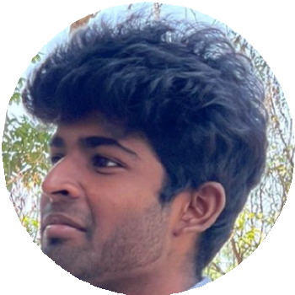



Thank you
GOWSEIK V
+91 6381469744
gowseikbablu@gmail.com www.ambedkalam.in
#42, Vel Tech Road, Vel Nagar, Avadi,
Chennai, Tamilnadu, 600062

